Slide 1
DECODING FOOTBALL WITH DATA
NAME : KATHIRAVAN P
MENTOR NAME : JAYA PANDEY

Slide 2
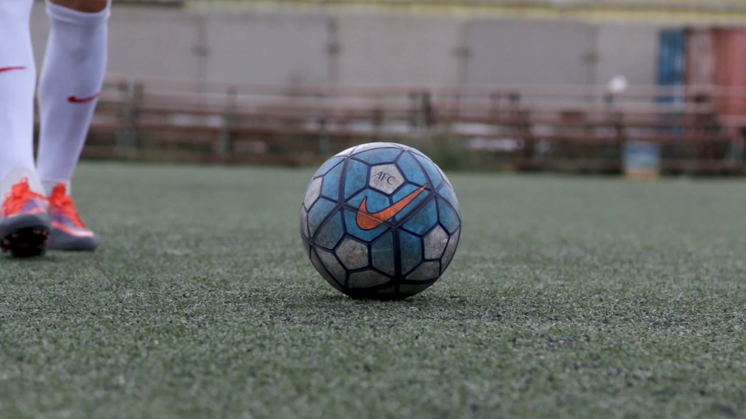

Slide 3

Football Data Analysis: Key Insights and Business Impact
This project analyzes a comprehensive football dataset to uncover success factors in performance, player profiles, team comparisons, attendance, referees, substitutions, events, competitions, demographics, and contracts. Using tools like Python, MySQL, Tableau, and Excel, we apply statistical and machine learning models to extract actionable insights.
Our goal is to enhance decision-making for coaches, scouts, and managers by leveraging data-driven strategies that improve player performance, team tactics, fan engagement, and business outcomes.

Slide 4

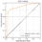
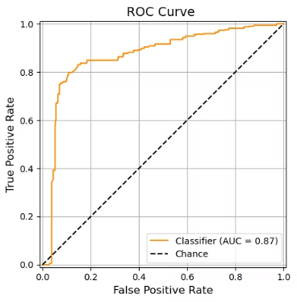
Performance Analysis
Goal Prediction Model
ROC AUC CURVE
Using logistic regression, player goals were predicted with 86% accuracy based on minutes played, position, competition, and captain status.
Central Limit Theorem Validation
Random sampling confirmed that sample means approximate a normal distribution regardless of population distribution, proving the CLT with sample mean close to population mean.

Slide 5
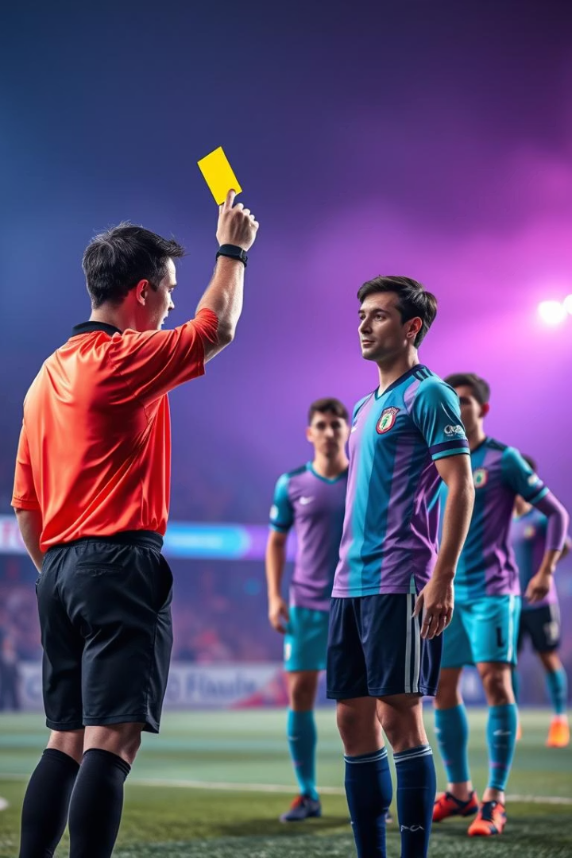
Player Profiles and Height Prediction
Disciplinary Records
John Anthony Brooks leads with the highest number of yellow cards, followed by Emmanuel Sabbi and Weston McKennie.
Player height Prediction
Linear regression models predict player height using physical traits, recent performance, market value with an R2 score of 0.66, indicating moderate accuracy.

Slide 6
Team Comparison Analysis Height Hypothesis
H0 -- NULL HYPOTHESIS
Ha -- ALTERNATE HYPOTHESIS
Team Height Differences
The null hypothesis in an ANOVA test assumes that there is no significant difference between the means of the groups being compared.
ANOVA test shows significant differences in average player heights among top teams, rejecting the null hypothesis of equal means.
The alternative hypothesis suggests that at least one group mean is different from the others.

Slide 7
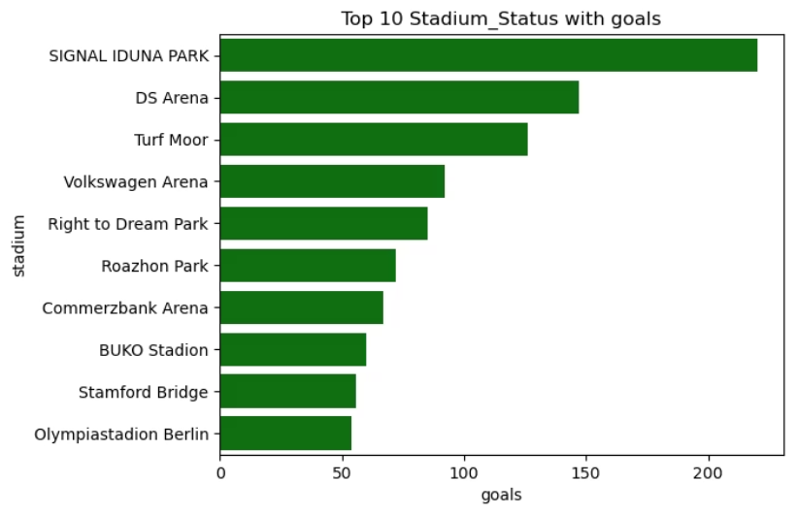
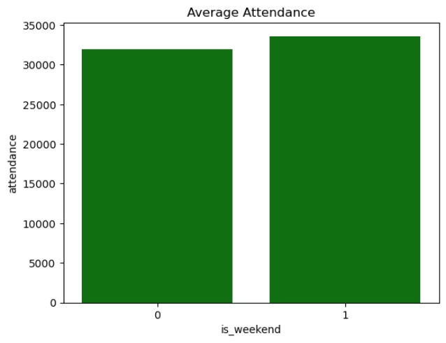
Attendance and Stadium Analysis
Attendance Patterns
Weekend matches have higher average attendance than weekdays, though the difference is moderate. SIGNAL IDUNA PARK recorded the highest goals scored among stadiums.

Slide 8
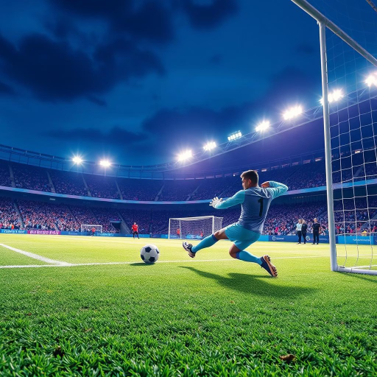
Goal Range Prediction - KNN MODEL
KNN model predicts expected goal range by stadium and competition with precision and recall around 76%,
and ROC AUC of 0.82.
We can easily identify whether the stadium(venue) is low scoring venue or high scoring venue

Slide 9
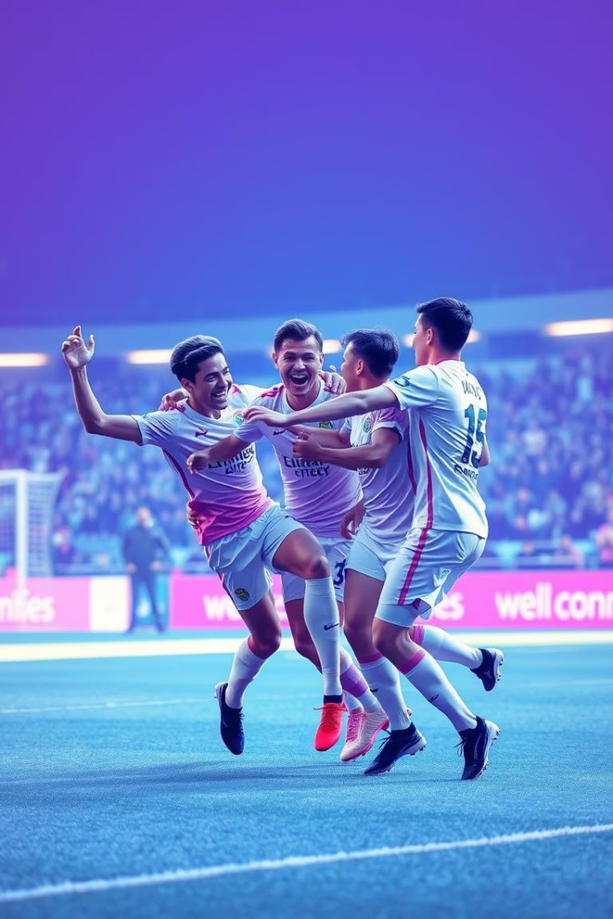


Event and Player Performance Hypothesis Testing
Weekend vs Weekday Goals
T-test shows no significant difference in goals scored between weekends and weekdays; averages are similar.
Height and Goal Scoring
Z-test indicates taller players (>178 cm) not score significantly more goals than shorter players, accept the null hypothesis.

Slide 10
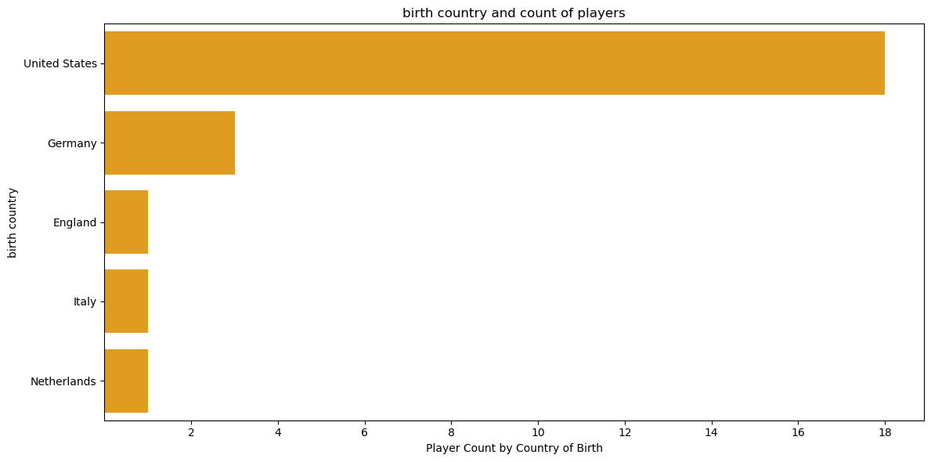
Player Demographics and Clustering Insights
Birth Country Distribution
Most players are born in the United States, followed by Germany, highlighting key talent origins.

Slide 11
K Means clustering
Player Segmentation
K-means clustering (k=4) shows well-separated player groups based on demographics and attributes, supporting strategic team-building.
The silhouette score is 0.796
The calinski_harabasz score is 14790.92
The davies_bouldin score is 0.38

Slide 12
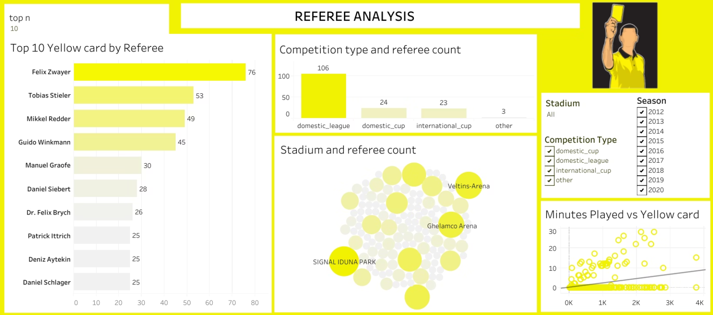

Slide 13

Referee Analysis and Match Impact
Referee
Yellow Cards Issued
Felix Zwayer
76
Tobias Stieler
53
Mikkel Redder
49
Referees vary in strictness; Zwayer issues the most yellow cards, possibly reflecting intense match styles or stricter officiating. Domestic leagues have the most referees, indicating workload distribution. Longer matches see more cards, suggesting increased referee vigilance or player fatigue.
High referee diversity in major stadiums like SIGNAL IDUNA PARK suggests neutral and fair match assignments.

Slide 14
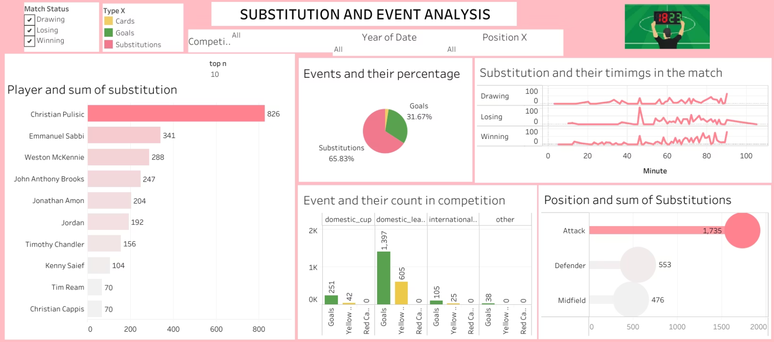

Slide 15
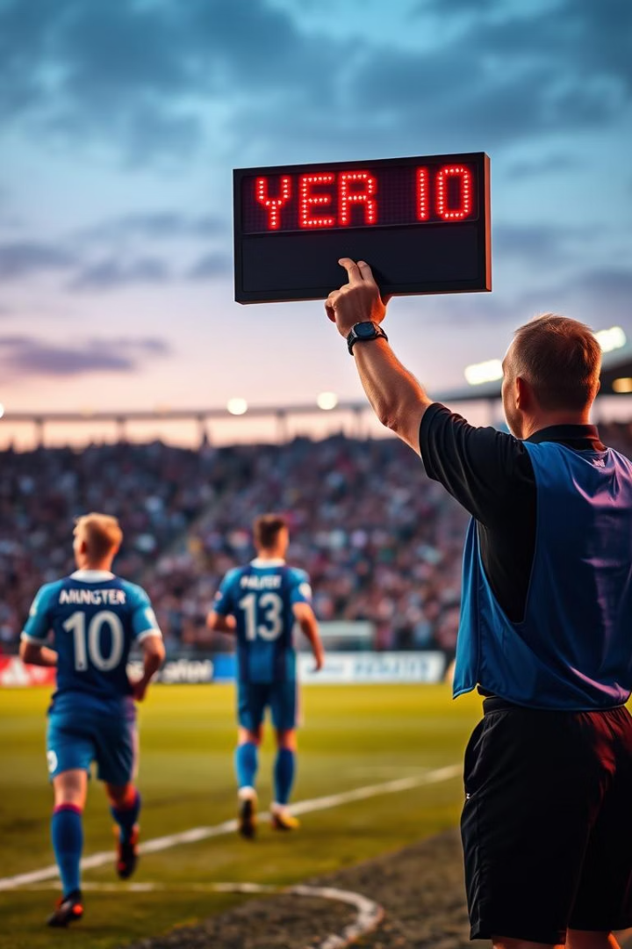
Substitution Patterns and Tactical Insights
Position Substitutions
Attackers are substituted most frequently (1,735 times), reflecting tactical adjustments and fatigue management.
Top Substituted Players
Christian Pulisic leads with 826 substitutions, indicating high usage and strategic fitness management.
Timing and Match Status
Substitutions peak at 45-60 and near 90 minutes, varying by match status: losing teams substitute earlier, winning teams later to defend leads.

Slide 16
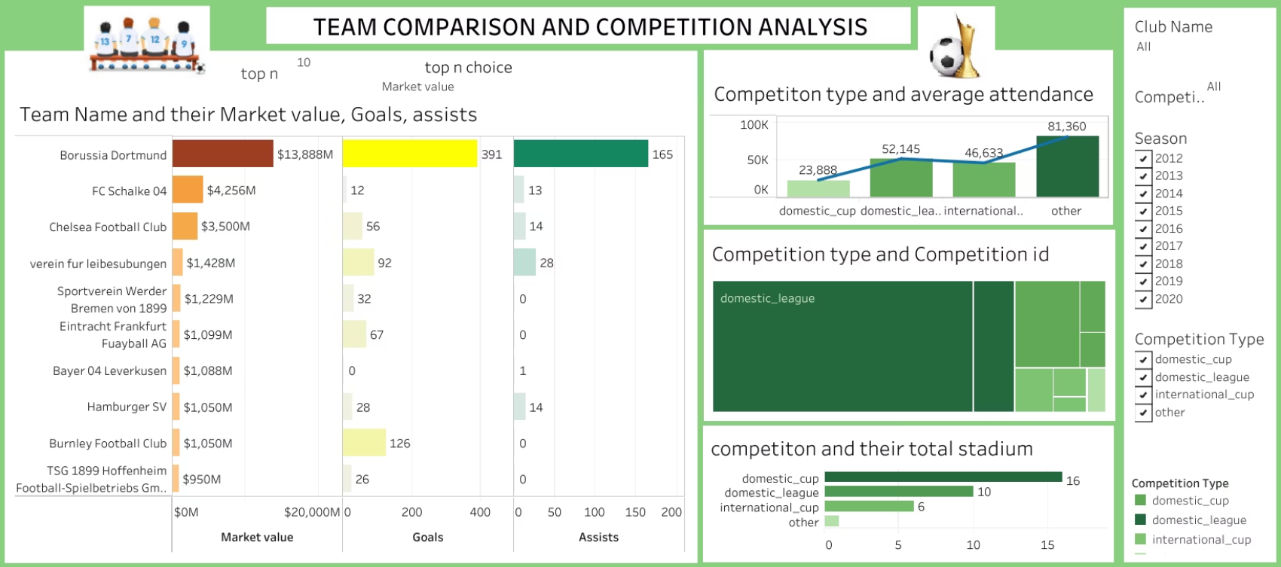

Slide 17
Competition and Team comparison
Competition Types
Team
Domestic Cup uses the highest number of stadiums (16), indicating:
Domestic leagues dominate in volume and stadium usage; "Other" competitions have highest average attendance, indicating special events.
Borussia Dortmund
Matches are widely spread geographically, possibly involving clubs from various regions and tiers.
Market Value: $13.888M (highest)
Goals: 391
Assists: 165
International Cup and Domestic League both use 6 stadiums:
→ Insight: Exceptionally high value matches with on-field dominance, showing great return on investment.
Indicates more centralized or repeated use of popular stadiums.

Slide 18
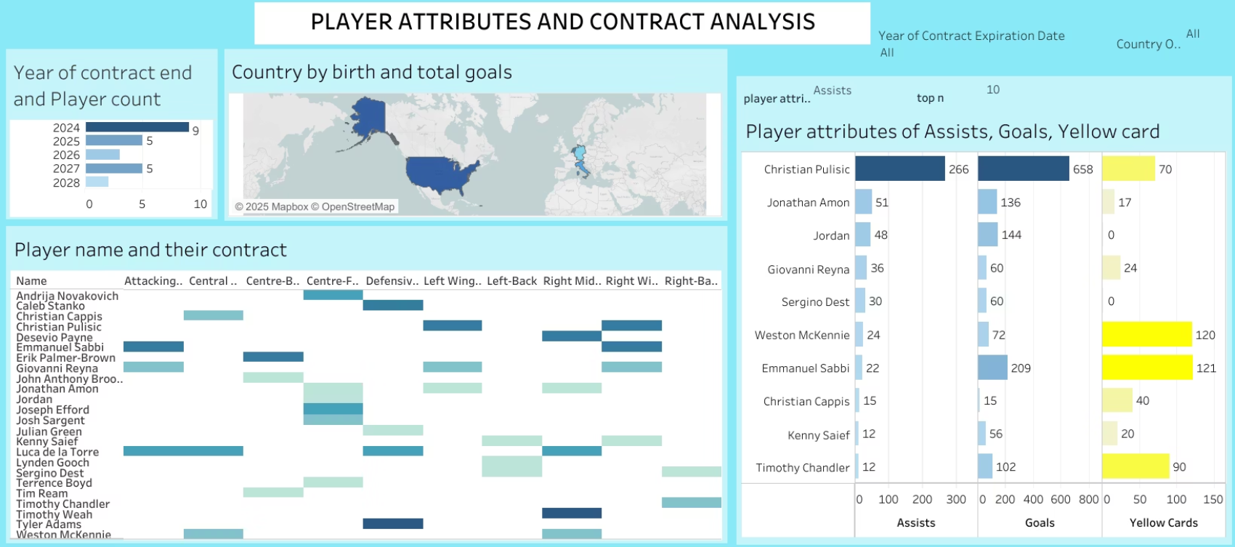

Slide 19
Player Attribute And Contract Insights
Player Market Value
Christian Pulisic has the highest market value, followed by Weston McKennie and others, guiding transfer and contract decisions.
Player position
Several players in Right Midfield, Right Winger, and Centre-Back positions have contracts expiring soon (2024).
Some key positions like Left-Back and Defensive Midfield have fewer players, highlighting potential future shortages.
Versatile players playing in multiple positions (e.g., Christian Pulisic) offer flexibility, but their contract status should be reviewed carefully.

Slide 20
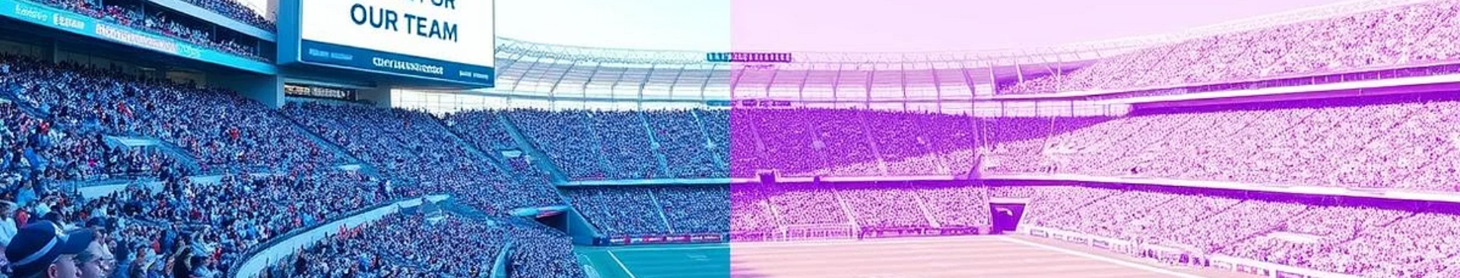
Contract Management and Player
Contract Expirations
In 2025 and 2027, 5 players each have contracts ending.
The highest number of player contracts (9) are set to expire in 2024.
→ These are medium-term contract expiries and should be monitored to prevent last-minute negotiations.
→ Immediate attention is needed for renewals, extensions, or replacement scouting.
Only 2 players' contracts expire in 2028, showing that very few long-term contracts are currently in place.

Slide 21
Summary
Performance Prediction: Logistic regression predicts goal-scoring with 86% accuracy using player minutes, position, and competition.
Team Height Differences: ANOVA confirms significant height variations among top teams (e.g., Borussia Dortmund vs. FC Schalke 04).
Stadium Impact: SIGNAL IDUNA PARK records most goals (220); weekends see higher attendance but marginal difference vs. weekdays.
Referee Patterns: Felix Zwayer issues most yellow cards (76), suggesting strict officiating; longer matches correlate with more cards.

Slide 22
Tactics: Attackers are most substituted (1,735 times); Christian Pulisic leads substitutions (826), indicating tactical/fitness roles.
Player Demographics: Most players are from the U.S. (highest goals) and aged 19–22; older players (>27) are fewer.
Contract Management: 9 player contracts expire in 2024—urgent renewals needed, especially for Right Midfield/Centre-Back positions.
Attendance Insights: Santiago Bernabéu has highest average attendance (76,894); weak correlation found between attendance and goals scored

Slide 23
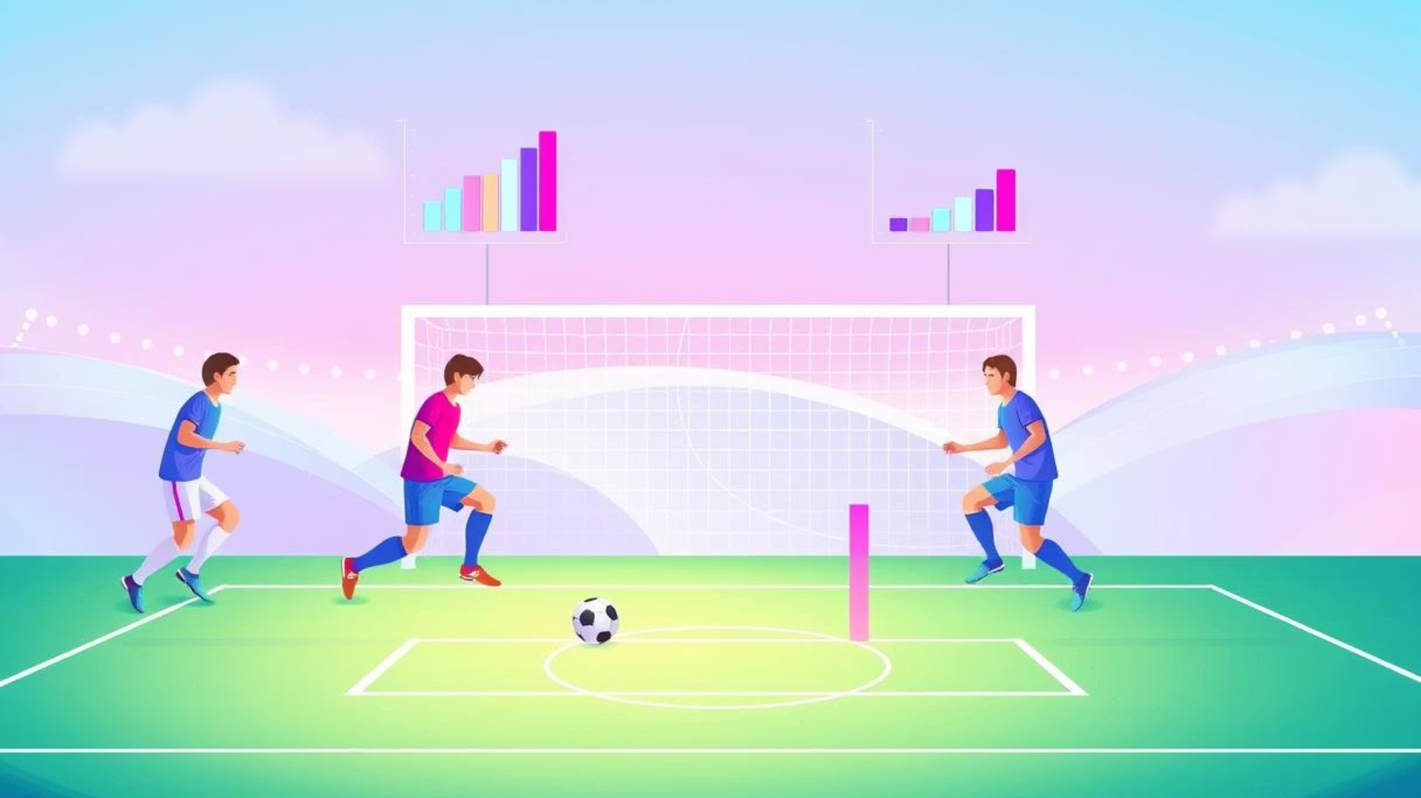




Conclusion and Business Implications
Data-driven insights
reveal key performance patterns, tactical substitution trends, and market value drivers.
Attendance and goal correlations
highlight marketing opportunities to boost fan engagement and revenue.
Urgent contract renewals
are vital to maintain competitive team strength in top leagues.
Strategic referee management
supports fair play and balanced match officiating.

Slide 24


Thank You
We appreciate your time and attention throughout this football data analysis presentation.
Looking forward to discussing strategic opportunities and next steps with you.
Questions Welcome
Feel free to ask about any insights or data details.

